Slide 1
UCSF CAPS/PRC Youth Advisory Panel
Connecting Youth, Research, and Health

Slide 2
Meeting Agenda
1. Welcome & Introductions 2. Review YAP By-Laws 3. Mobile Tech Stability Survey 4. WYZ Study Update

Slide 3
Group Introductions
Welcome & Introductions
State Your Name
Your Pronouns
Your First Job

Slide 4
Review By-Laws
Community-Research Partnerships

Slide 5
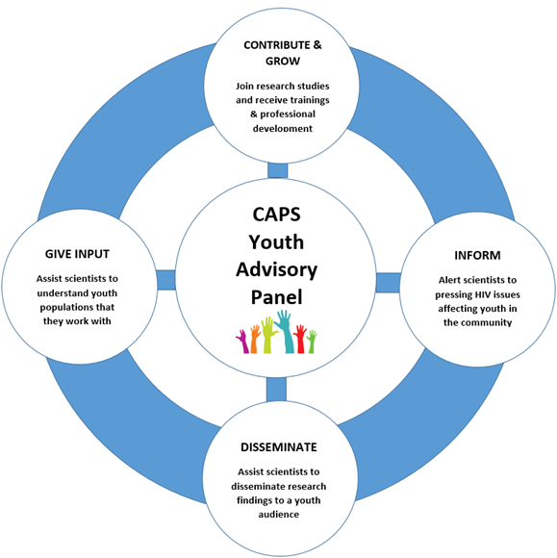
YAP Mission
Notes:
Our group emphasizes trainings, collaborative development, and strengthening of the community-research partnership to more effectively address the HIV epidemic among young people.

Slide 6
Attendance & Participation
We meet three times a year for 2 hours, so your attendance, active participation, and staying for the entire meeting is critical to achieve our mission.
If you know you will not be able to make it, please let us know as soon as possible.

Slide 7
Development & Compensation
We provide opportunities for you to contribute to research and to grow personally and professionally.
We value of your time and contributions and will compensate $80 for attending meetings in person.
This is meant to cover transportation and off-set other expenses resulting from participation in YAP.
Notes:
We believe PLWH have the right and responsibility for self-determination and active participation in decision-making that affects their lives. As such, we strive to uphold the principles of greater involvement of people living with HIV by creating space for meaningful involvement in the response to the epidemic.
You were selected because you showed potential to become a leader within your community – and we want to be able to help provide opportunities for developing your leadership and advocacy skills. While, we do not specifically compensate you for professional development opportunities – it is nonetheless an important part of your participation in this group.
We also recognize the value of your time and contribution to this work – and we do not expect you to do this work for free – so we do compensate you for attending meetings in person. This compensation is meant to cover transportation expenses – and to help off-set any other expenses that you may incur as a result of participating in this group.

Slide 8
Communication & Confidentiality
We aim to be thoughtful in our communication and keep our messages brief. In return, we ask that you respond to YAP team messages in timely manner.
We put together quarterly bulletin to provide updates and to inform you of development opportunities.
We take confidentiality seriously and ask for your help to ensure this group remains a safe space for everyone.

Slide 9
Mobile Phone Technology Stability
Notes:
1) Benefits of Mobile Tech Are Many
2) Impacts of Unstable Access To Mobile Tech Under-Explored
3) Develop Survey To Assess Impact
4) Need Input To Ensure Questions Are Relevant & Interpretable

Slide 10
Survey Instructions
The following questions are about your cell phone use in the past 6 months.
Please let us know about your use of these devices by responding to the following questions.

Slide 11
Question 1
I have had access to a cell phone at any time during the past 6 months:
A) Yes
B) No
C) Decline to answer

Slide 12
Question 2
This is my personal cell phone (i.e. I am the only one who uses the phone):
A) Yes
B) No
C) Decline to answer

Slide 13
Question 3
I have cellular service on this cell phone:
A) Yes
B) No
C) Decline to answer

Slide 14
Question 4
In the past 6 months, I have received Lifeline Assistance Program (i.e. Obama Phone):
A) Yes
B) No
C) Decline to answer

Slide 15
Question 5
In the past 6 months, my cell phone has been stolen at least once:
A) Yes
B) No
C) Decline to answer

Slide 16
Question 6
In the past 6 months, I have had at least one break in my cell phone service:
A) Yes
B) No
C) Decline to answer

Slide 17
Question 7
In the past 6 months, my cell phone has been disconnected (cut off) because I couldn’t pay the bill:
A) Yes
B) No
C) Decline to answer

Slide 18
Question 8
In the past 6 months, I have had to forgo paying other bills so I could pay my cell phone bill:
A) Yes
B) No
C) Decline to answer

Slide 19
Question 9
In the past 6 months, I have had to forgo buying necessary items so I could pay my cell phone bill:
A) Yes
B) No
C) Decline to answer

Slide 20
Question 10
In the past 6 months, I have had to forgo paying my cell phone bill because I had to pay for other things:
A) Yes
B) No
C) Decline to answer

Slide 21
Question 11
In the past 6 months, I have had to limit using my phone for any purpose (e.g. make calls, send text messages, or use the internet) so that I could keep my cell phone bill low:
A) Yes
B) No
C) Decline to answer

Slide 22
Question 12
In the past 6 months, I have used free internet services (such as Google Voice, WhatsApp, or Facebook Messenger’s phone option) to make phone calls because I have not had cell phone service:
A) Yes
B) No
C) Decline to answer

Slide 23
Question 13
In the past 6 months, I cheeked email, sent text messages, search the internet, or made a call on my cell phone by using free Wi-fi because I could not afford to use my cell phone’s data:
A) Yes
B) No
C) Decline to answer

Slide 24
Question 14
In the past 6 months, I have felt anxious about not having enough data to use my cell phone:
A) Yes
B) No
C) Decline to answer

Slide 25
Question 15
In the past 6 months, I have felt nervous about not being able to pay my cell phone bill:
A) Yes
B) No
C) Decline to answer

Slide 26
Question 16
In the past 6 months, I have worried that if I lose my phone, I will be unable to replace it:
A) Yes
B) No
C) Decline to answer

Slide 27
Question 17
In the past 6 months, I have felt embarrassed of my phone for any reason (such as old model, cracked screen):
A) Yes
B) No
C) Decline to answer

Slide 28
Question 18
In the past 6 months, I have had to use a less reliable cell phone network because it was cheaper than other more reliable networks:
A) Yes
B) No
C) Decline to answer

Slide 29
Question 19
In the past 6 months, my frustration with my service has lead me to not make important phone calls:
A) Yes
B) No
C) Decline to answer

Slide 30
Question 20
In the past 6 months, my frustration with my internet connection has lead me to not search for important information that I needed:
A) Yes
B) No
C) Decline to answer

Slide 31
Question 21
In the past 6 months, I have had problems (e.g., missed an appointment, got lost, was unable to pay a bill, etc.) because my cell phone battery died.
A) Yes
B) No
C) Decline to answer

Slide 32
Question 22
If I no longer had access to a cell phone:
A) I would be just fine
B) I can probably get by with difficulty
C) I can’t imagine how I would get by

Slide 33
Question 23
Please rank the following in the order of their importance to you:
A) Access to clothing
B) Access to mobile phone
C) Access to reliable transportation
D) Access to stable housing
E) Access to sufficient nutritious food

Slide 34
WYZ Study Update
Notes:
Currently - Building Provider Portal
WYZ Study Start Date (May 2019)
Supporting WYZ Study (Being “Super-Users”)

Slide 35
WYZ Study

Slide 36
“Never doubt that a small group of thoughtful, committed citizens can change the world; indeed, it’s the only thing that ever has.”
- Margaret Mead, Anthropologist

